Slide 1
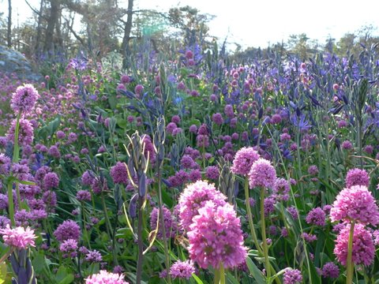


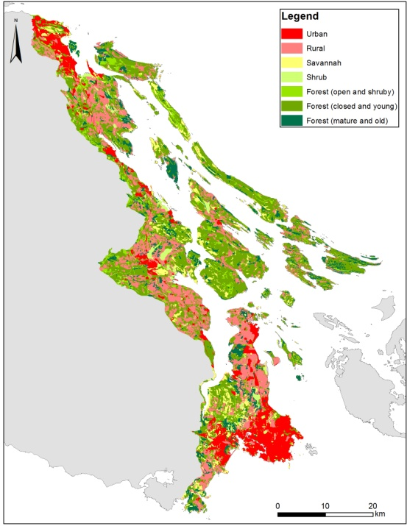
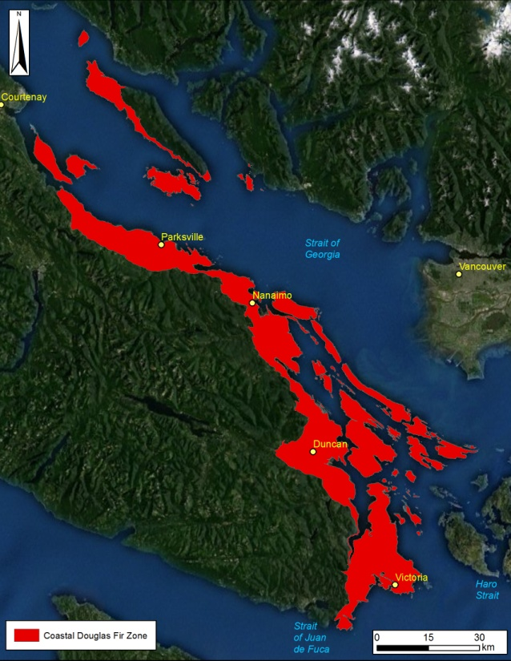
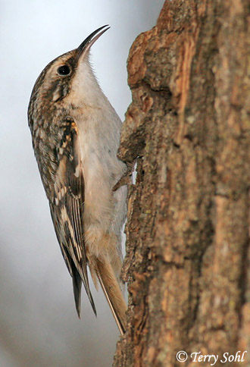
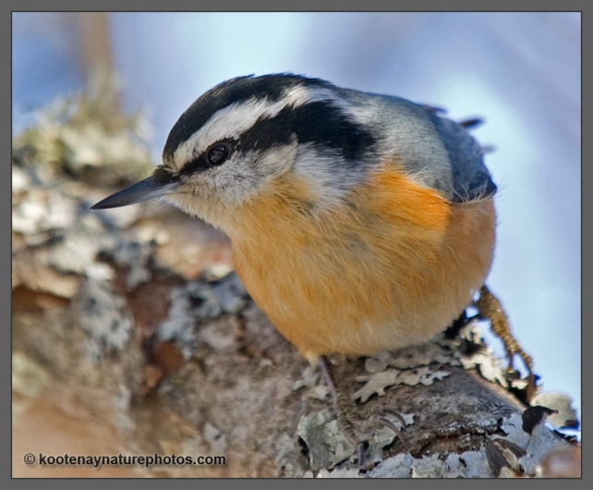
Conservation Prioritization: Introduction to the Coastal Douglas-fir
Richard Schuster
Liber Ero Fellow, Carleton University
Adjunct Prof, Ecosystem Science and Management Program, UNBC

Slide 2
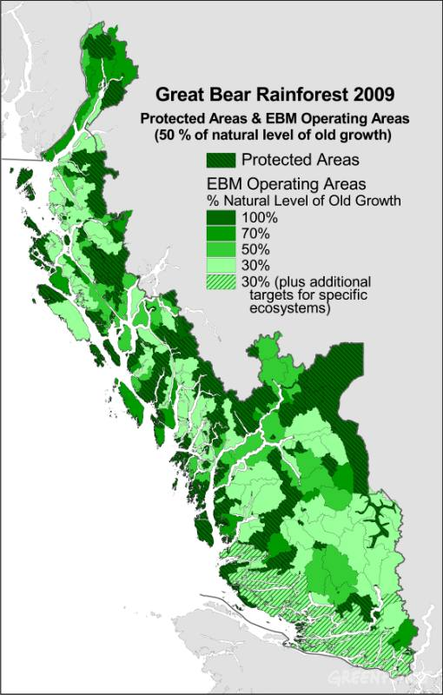
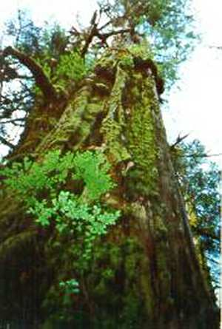
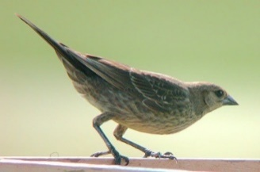
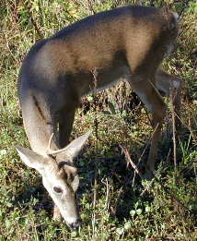
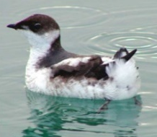
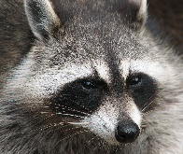
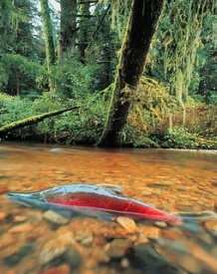
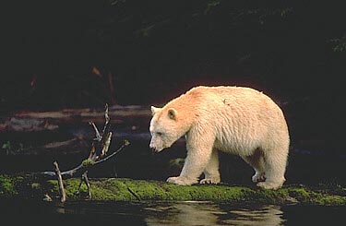
Traditional Goal of Conservation Area Design
Prioritize and Conserve ‘Intact’ or ‘Relic Ecosystems’
Multiple criteria
Decision support tools
Impractical in Human-dominated Landscapes
No Benchmark Ecosystems
Biological Survey Data Often Biased
Many Threats Hard to Map

Slide 3
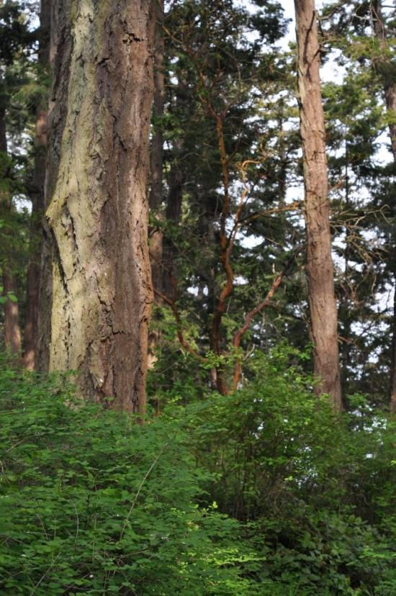
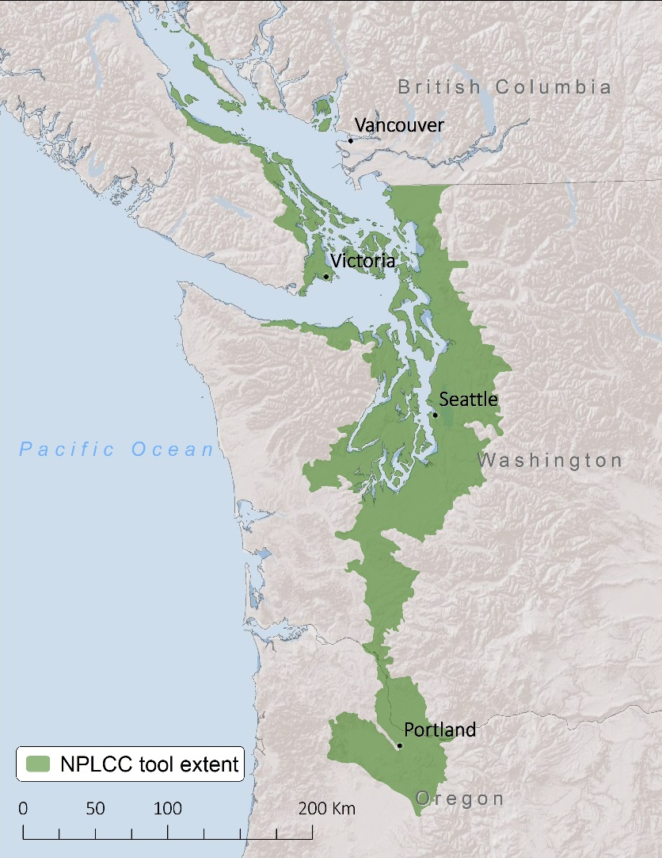
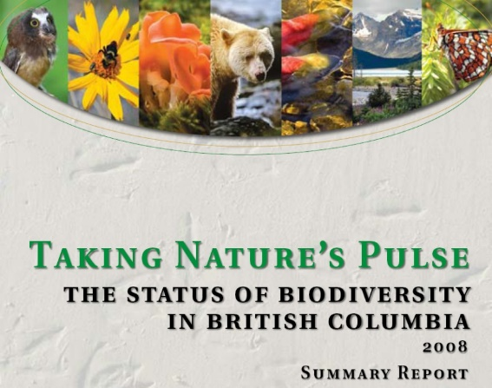
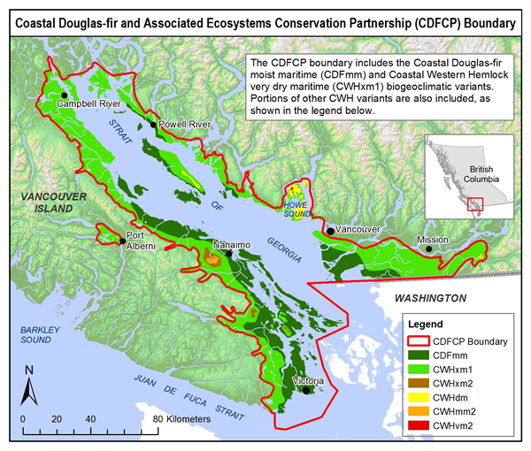
Dry Forest / Savanna Habitats of the Georgia Basin
49% Converted to Human Use
< 3% Pre-settlement Forest Intact
> 80% Privately-owned
>153 Species At Risk
Most Imperiled Ecosystem in BC
Vancouver
And Throughout the Pacific Northwest

Slide 4


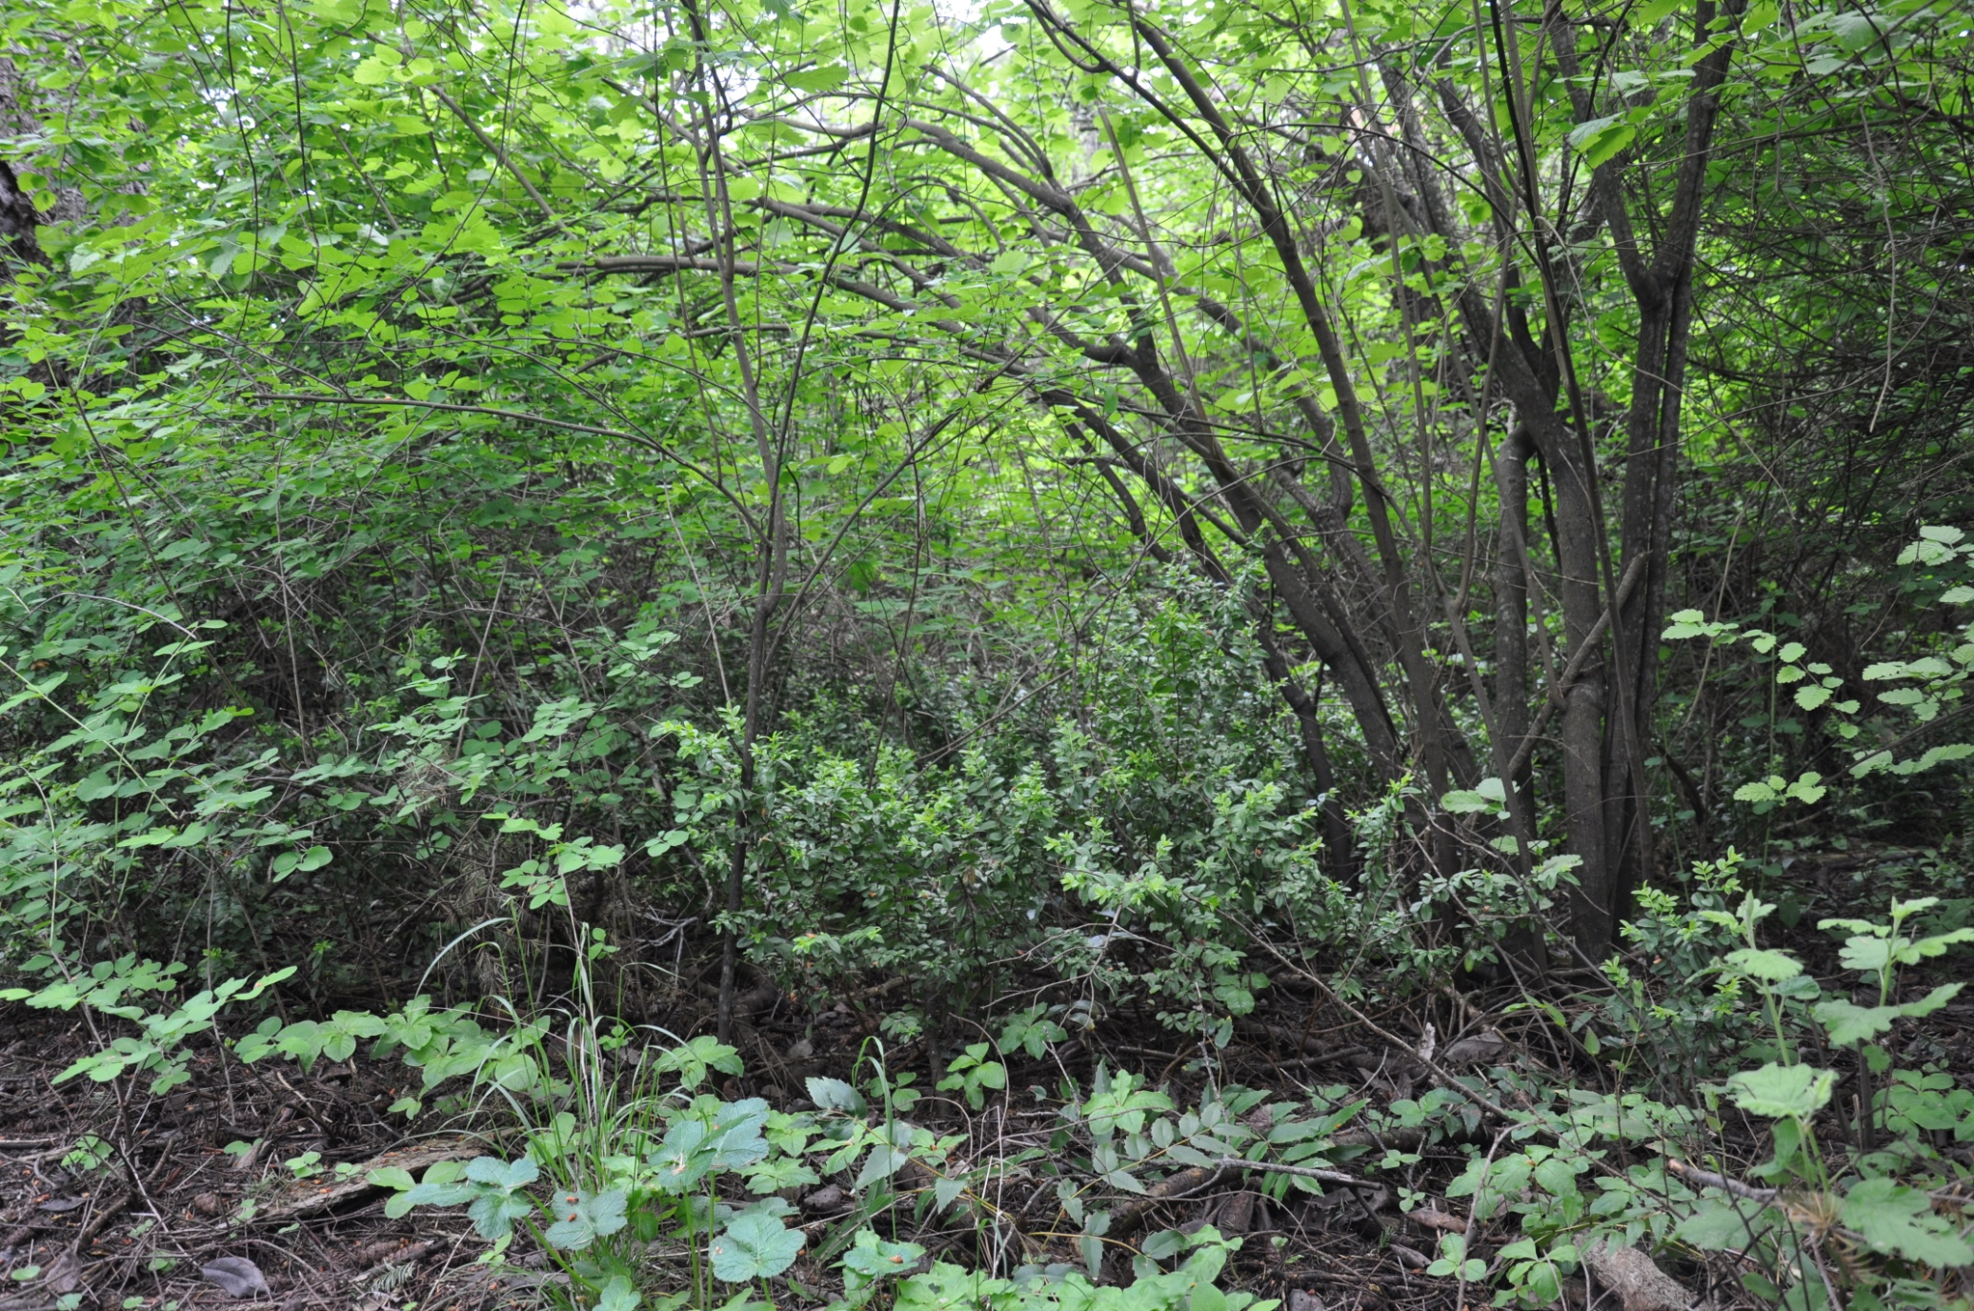
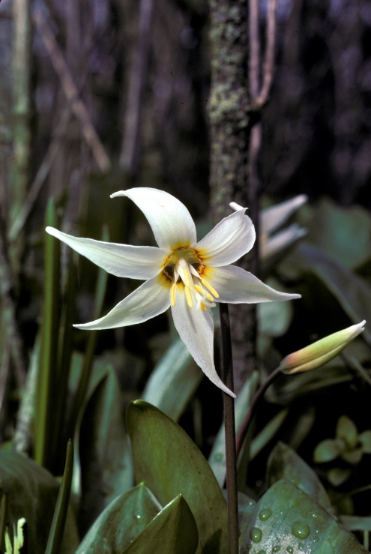
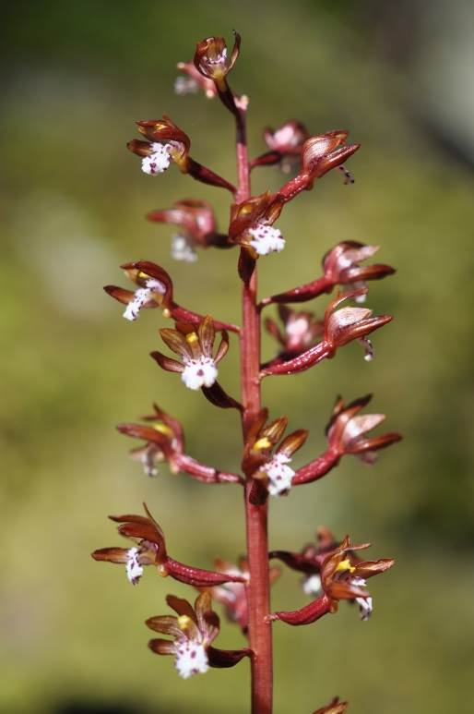
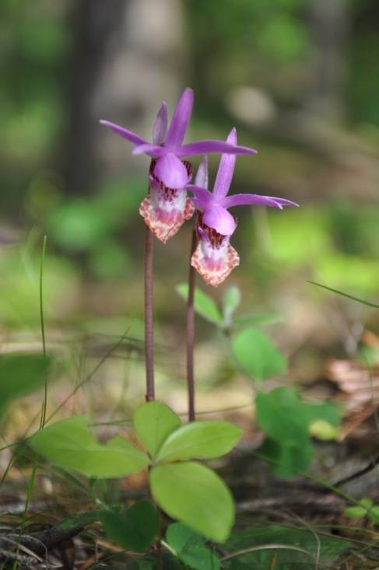
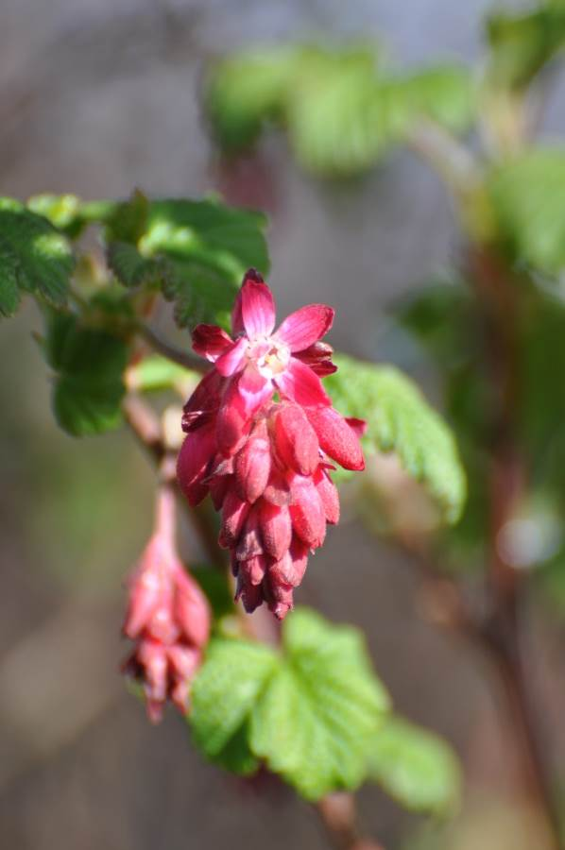
Forested Deep Soil Sites

Slide 5
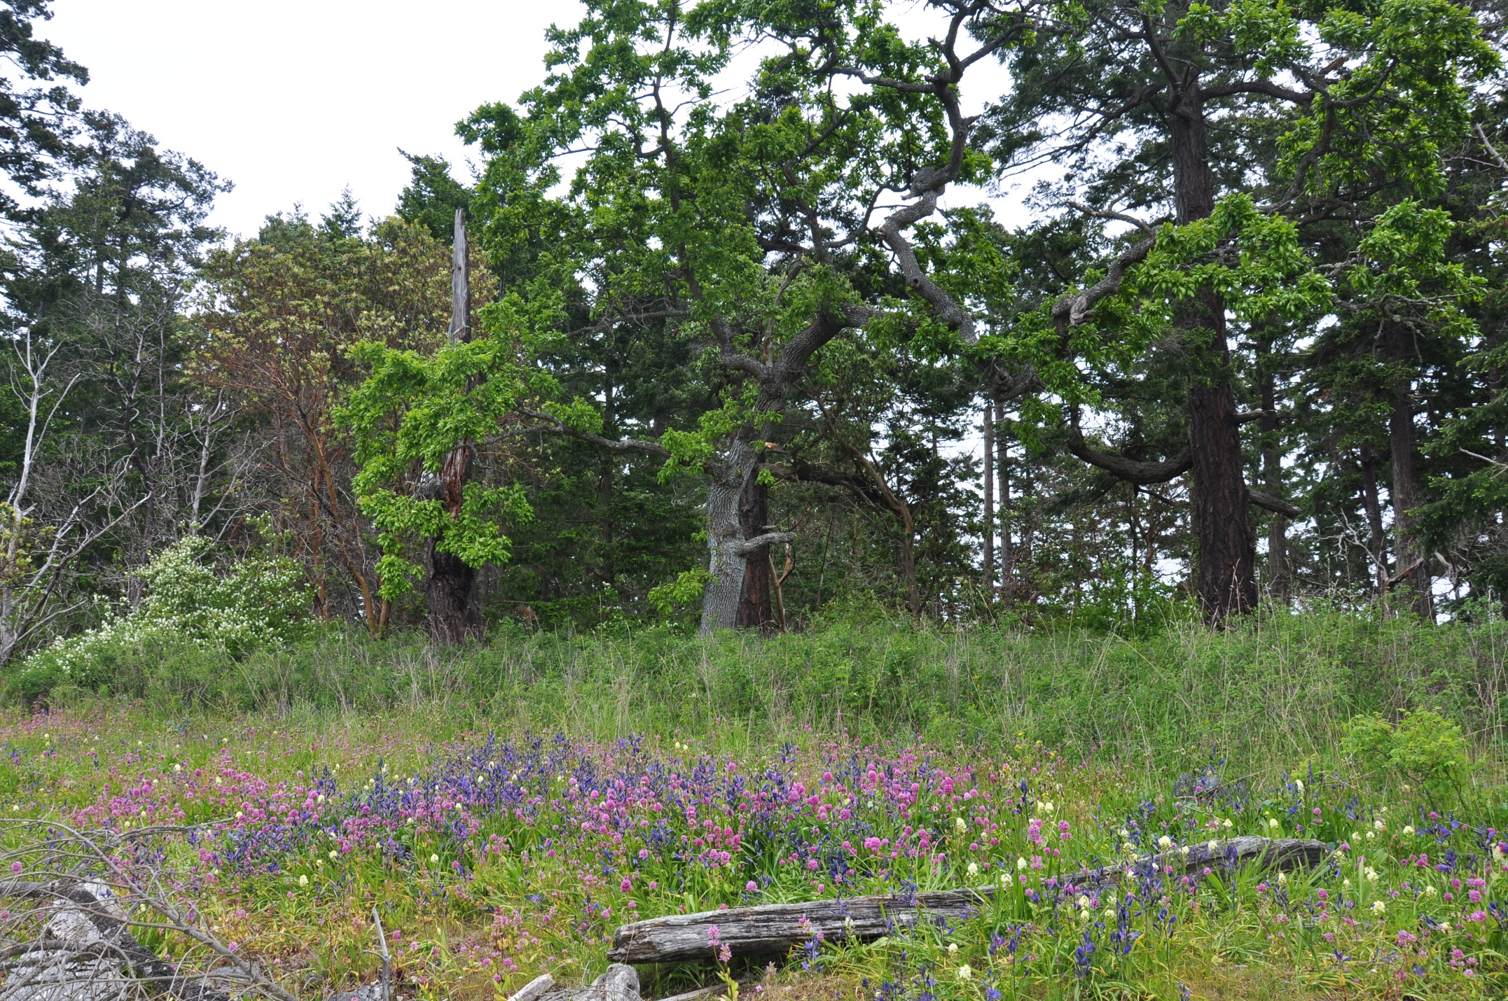
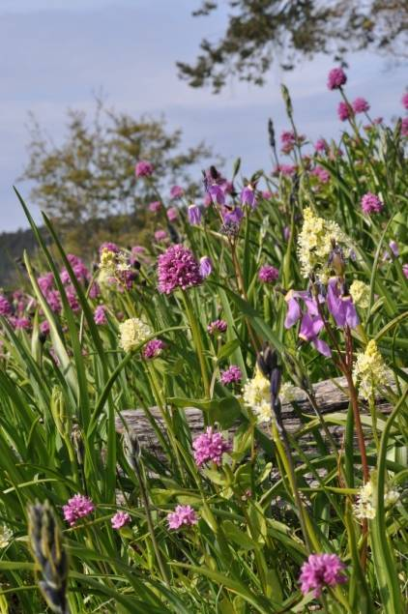
Shallow-soil `Garry Oak` Meadow and Woodland
High Alpha Diversity at Site Level
High Beta Diversity at Local Scales
High Gamma at Landscape Scales

Slide 6
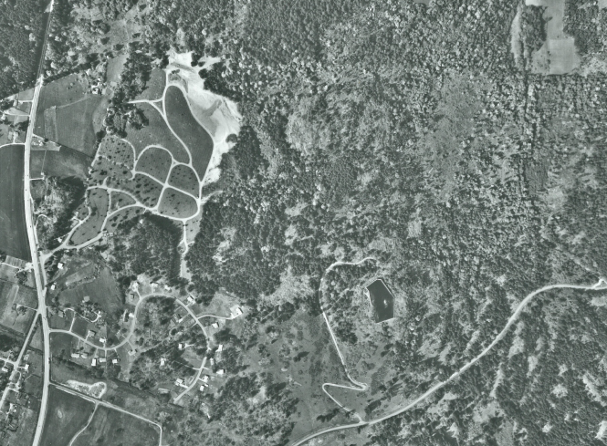
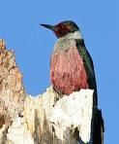
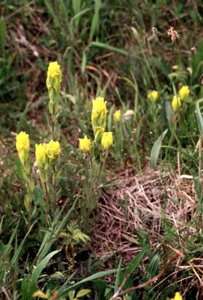
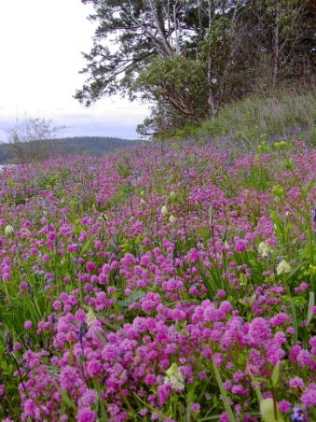
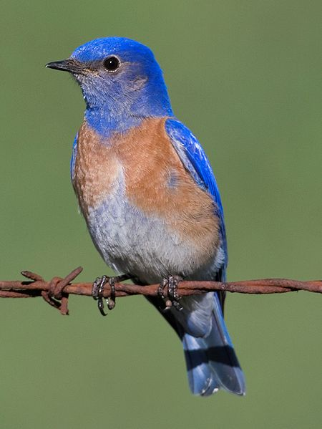
A Human Dominated Landscape
Lewis’s woodpecker
Golden Paintbrush
Royal Oaks, Victoria BC
Royal Oak 1964
Oak meadow
Key Concerns
Habitat loss/Fragmentation
Viability of Small Populations
Exotic Competitors/Predators
Over-abundant Species
Western bluebird

Slide 7
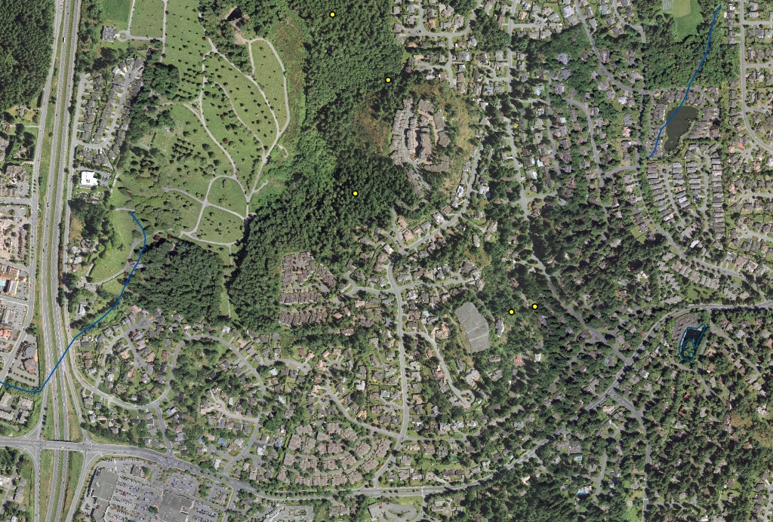
Habitat Loss and Fragmentation
Royal Oaks
Victoria, BC
1964 vs 2005
High Urgency, High Threat
Viability?

Slide 8
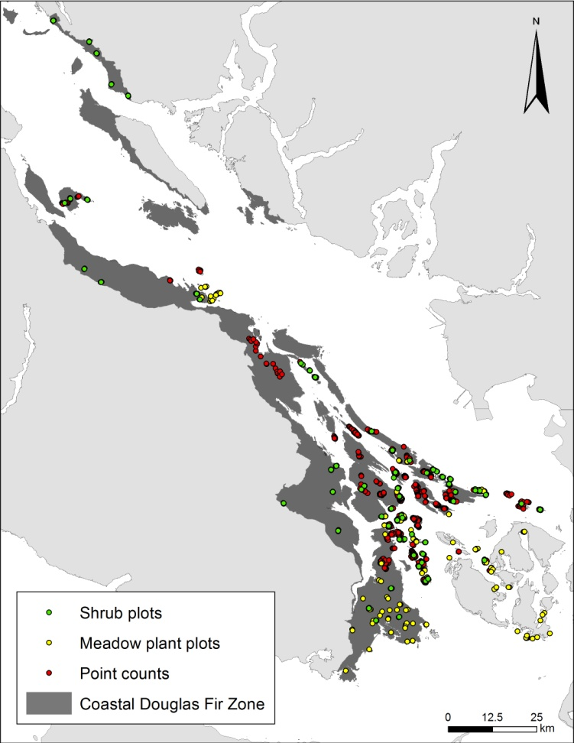

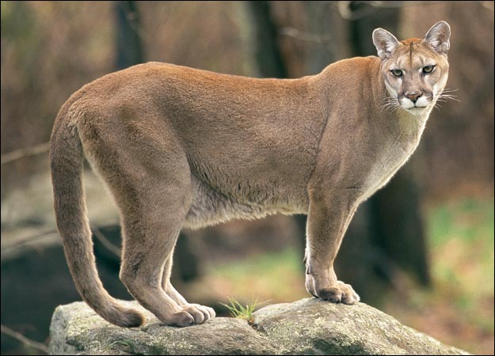


Indirect effects of humans: Deer in the CDFCP
- Historic Deer Densities Were Low due to Predation and Hunting
Deer Often Exceed 1/ha where Predators and Hunting are Absent
Animal Planet

Slide 9
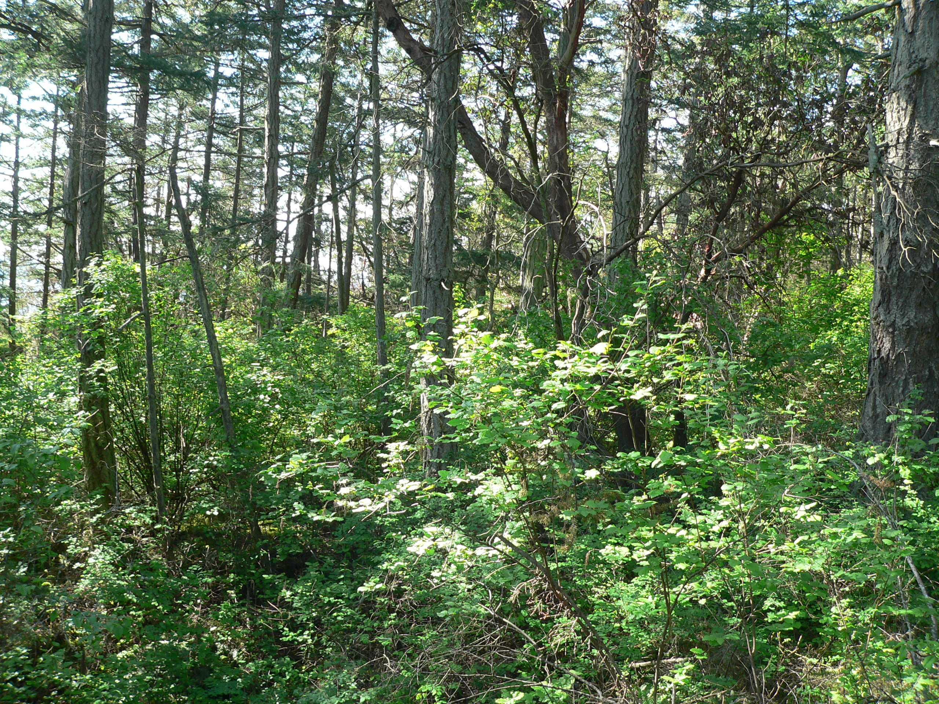

Slide 10
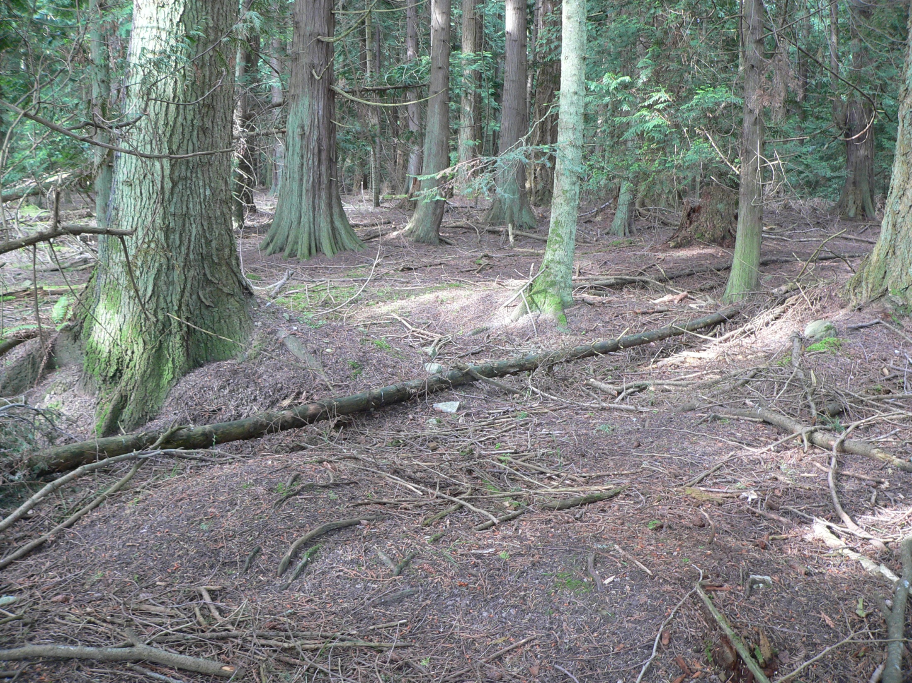

Slide 11
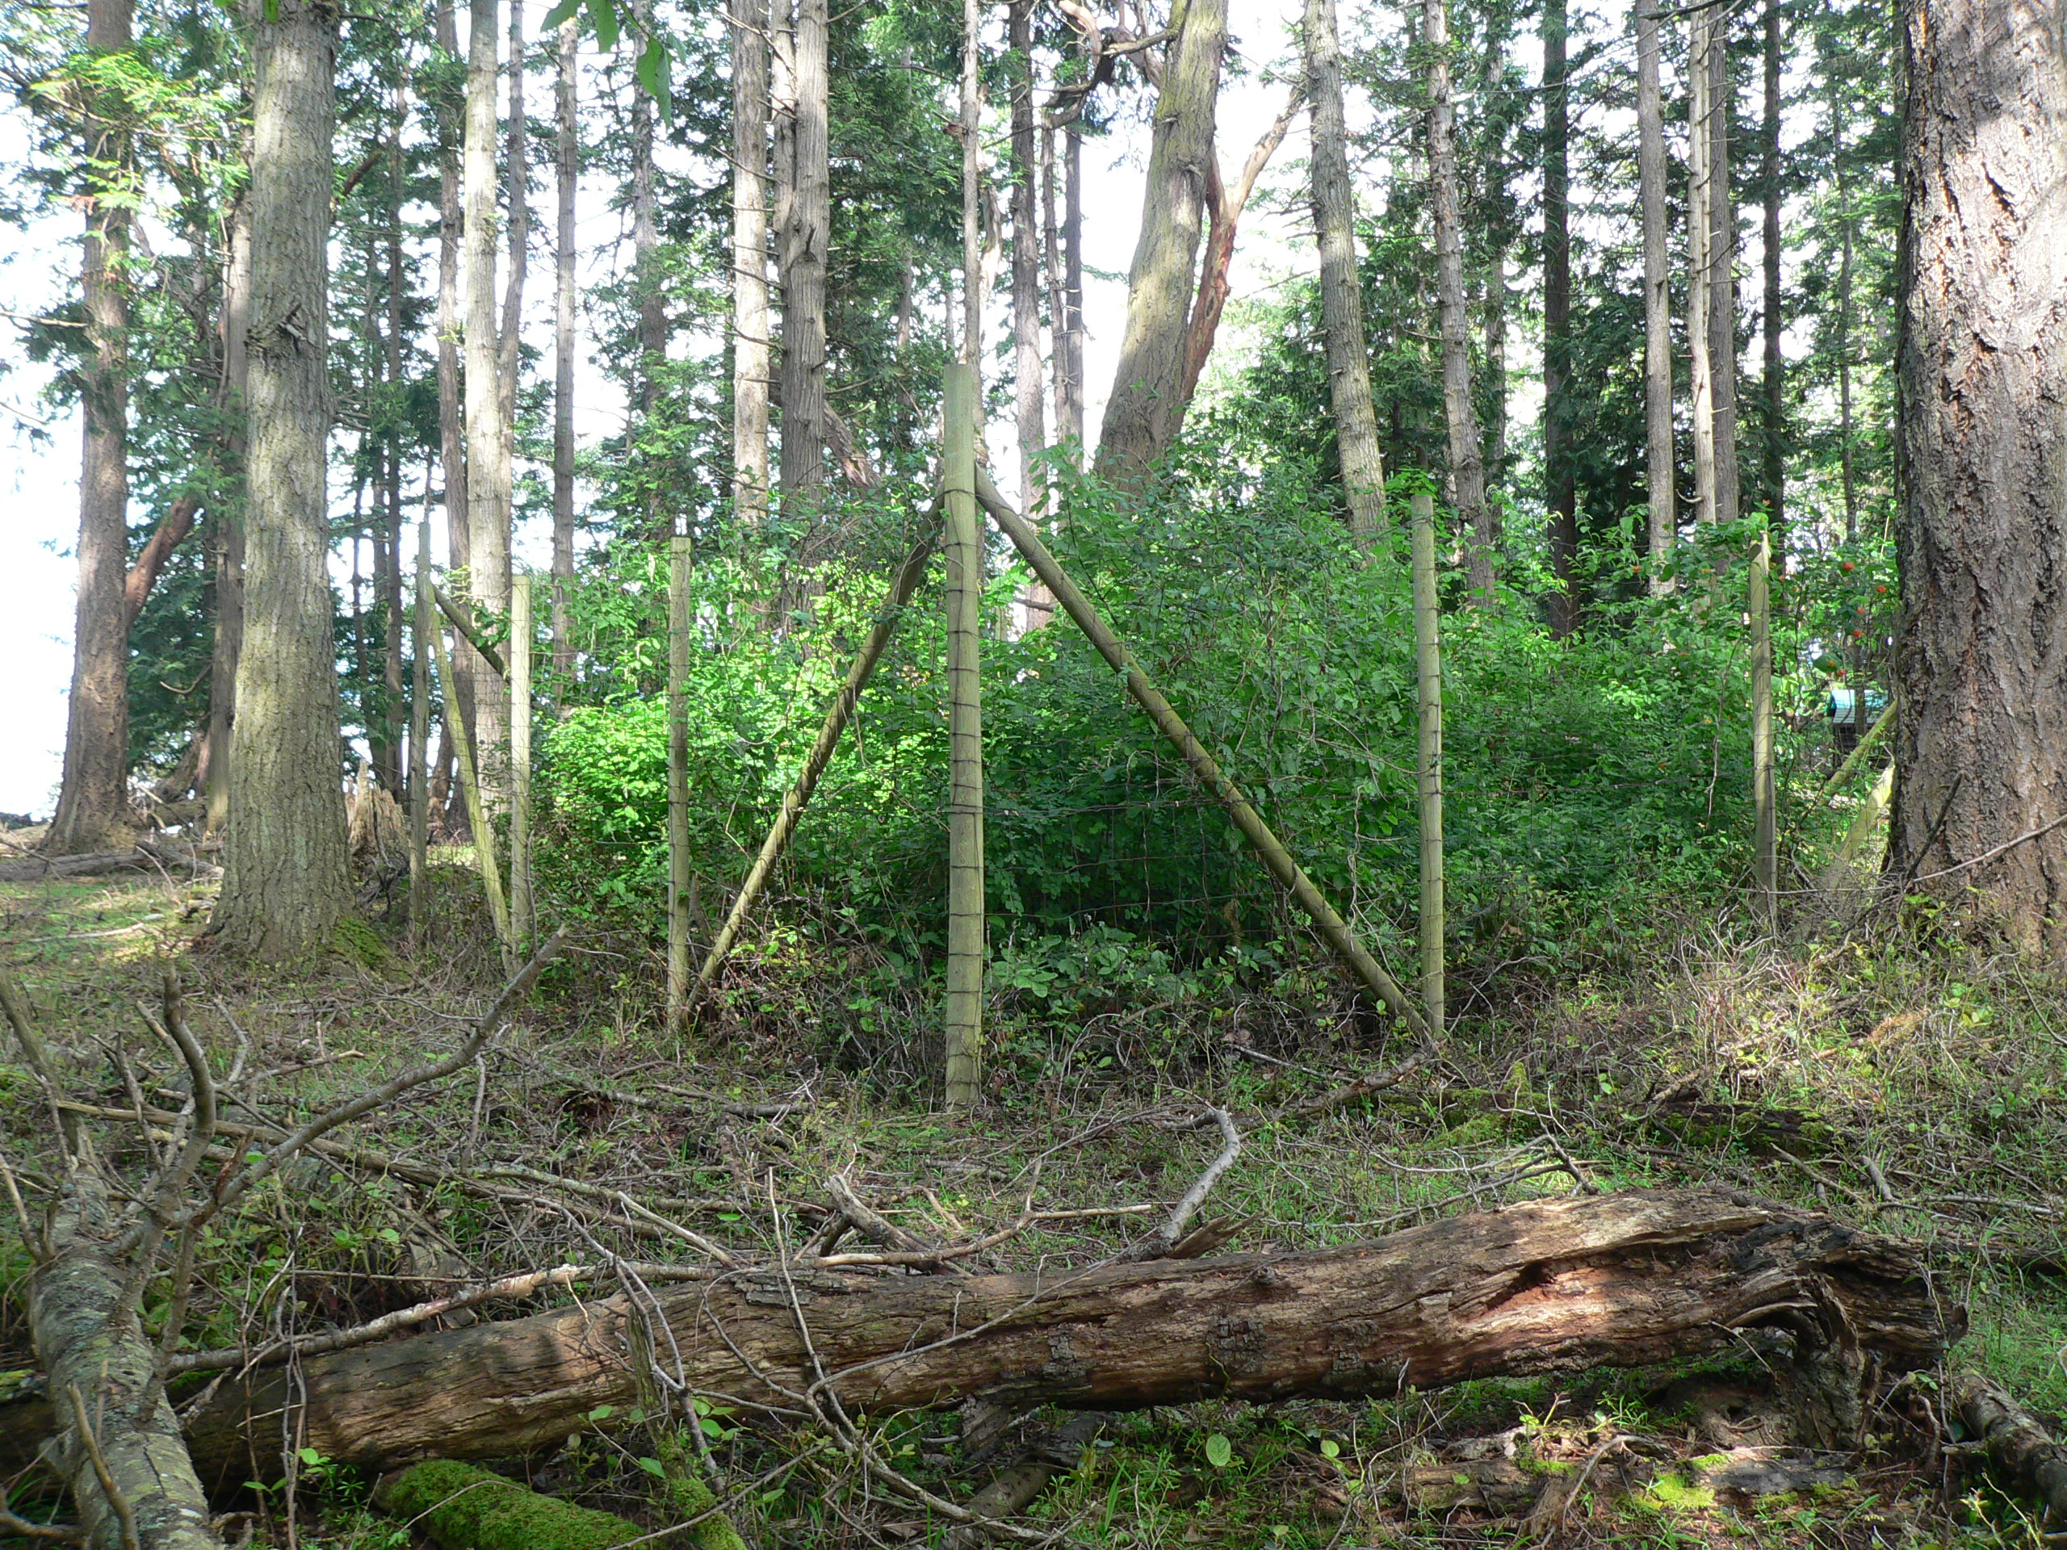

Slide 12
Conservation prioritization in the CDFCP area
Decision support tools: Marxan
Planning units (e.g. properties, watersheds, hexagons, …)
Species or Feature targets (e.g. protect 20% old forest, …)
Create compact reserve systems to reduce e.g. edge effects

Slide 13
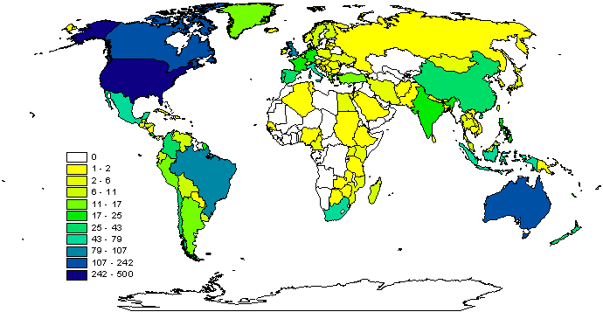
Why Marxan?
Aids systematic conservation planning
Near optimal spatial reserve systems
Most widely used worldwide
Transparent, inclusive and defensible decision making process
2009

Slide 14
What can Marxan do?
Identify areas that meet targets for a range of input features for minimal cost
Uses concept of complementarity (Select new conservation areas so that each one complements the others in the biodiversity features they contain)
Can maximise compactness
Can include data on ecological processes, threats, and condition
Decision-support, not a decision-maker

Slide 15
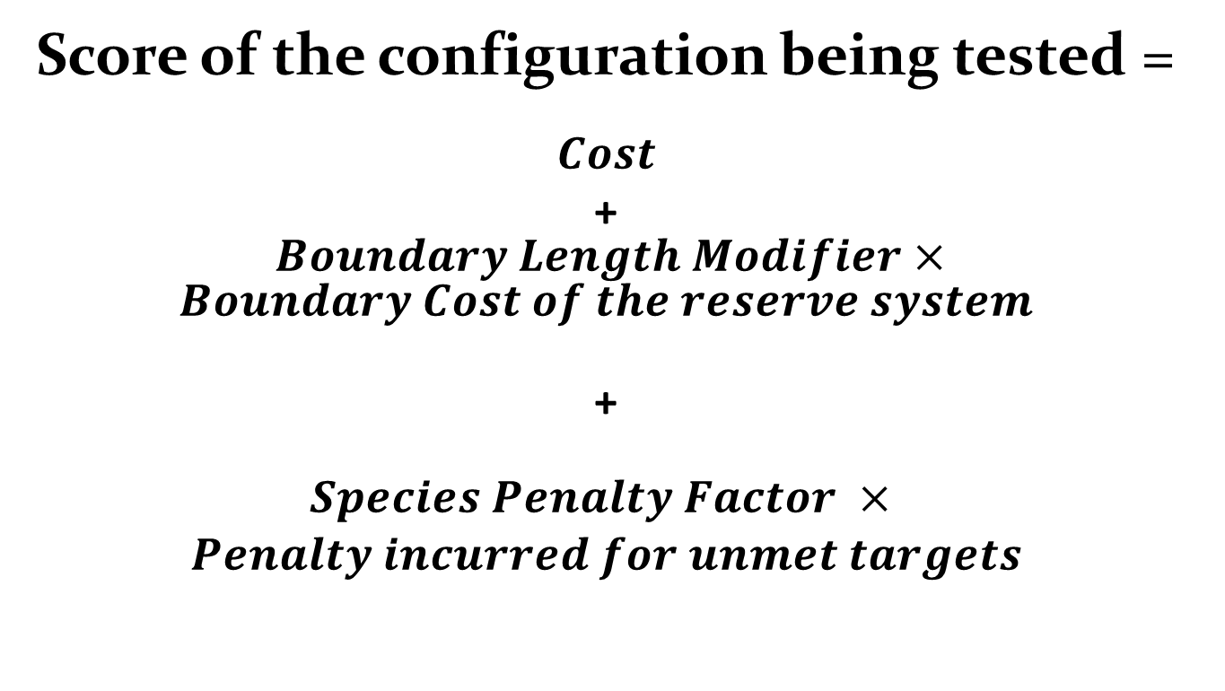
What problem does Marxan solve?
Score of the configuration being tested =
$$Cost$$
+ $Boundary Length Modifier×Boundary Cost of the reserve system$
+
$$\begin{aligned}Species Penalty Factor × \\ Penalty incurred for unmet targets\end{aligned}$$

Slide 16
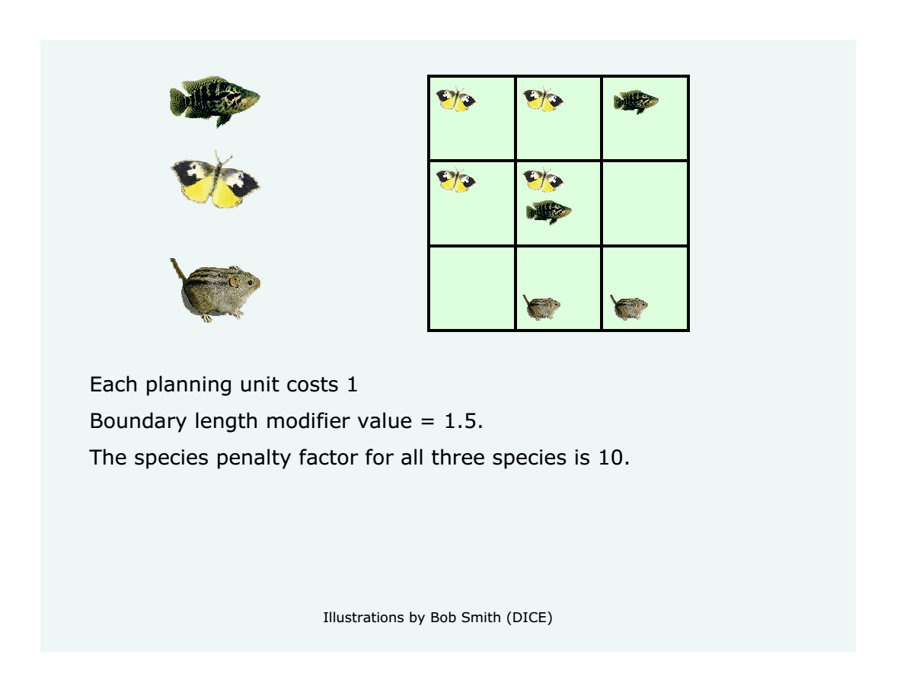

Slide 17
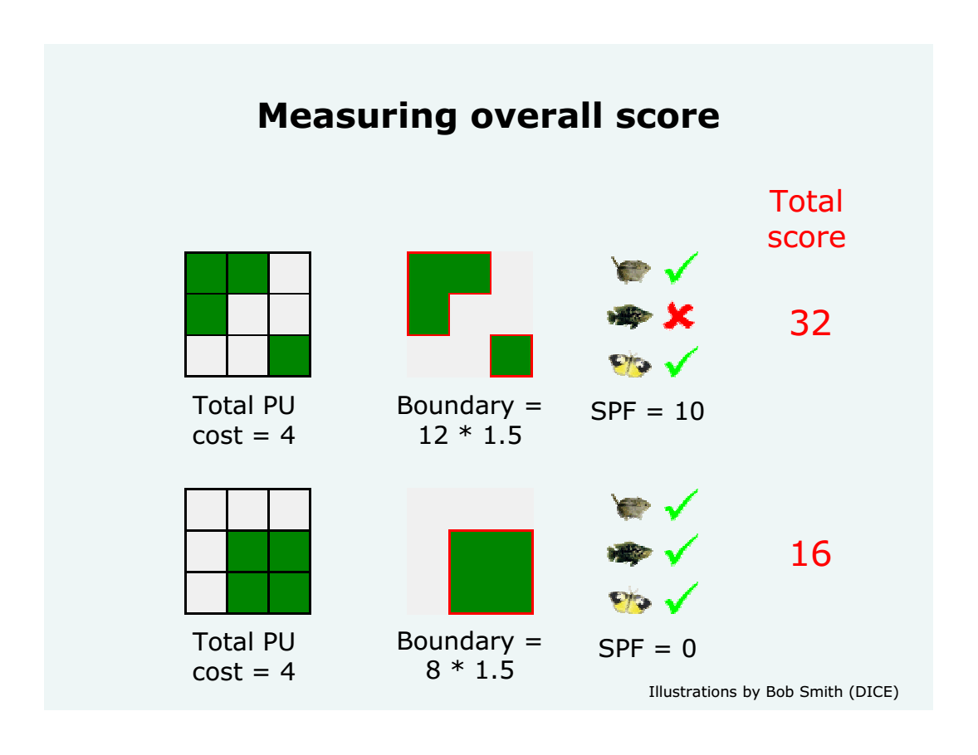
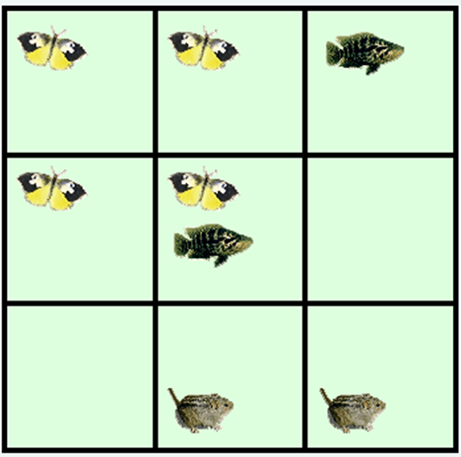

Slide 18
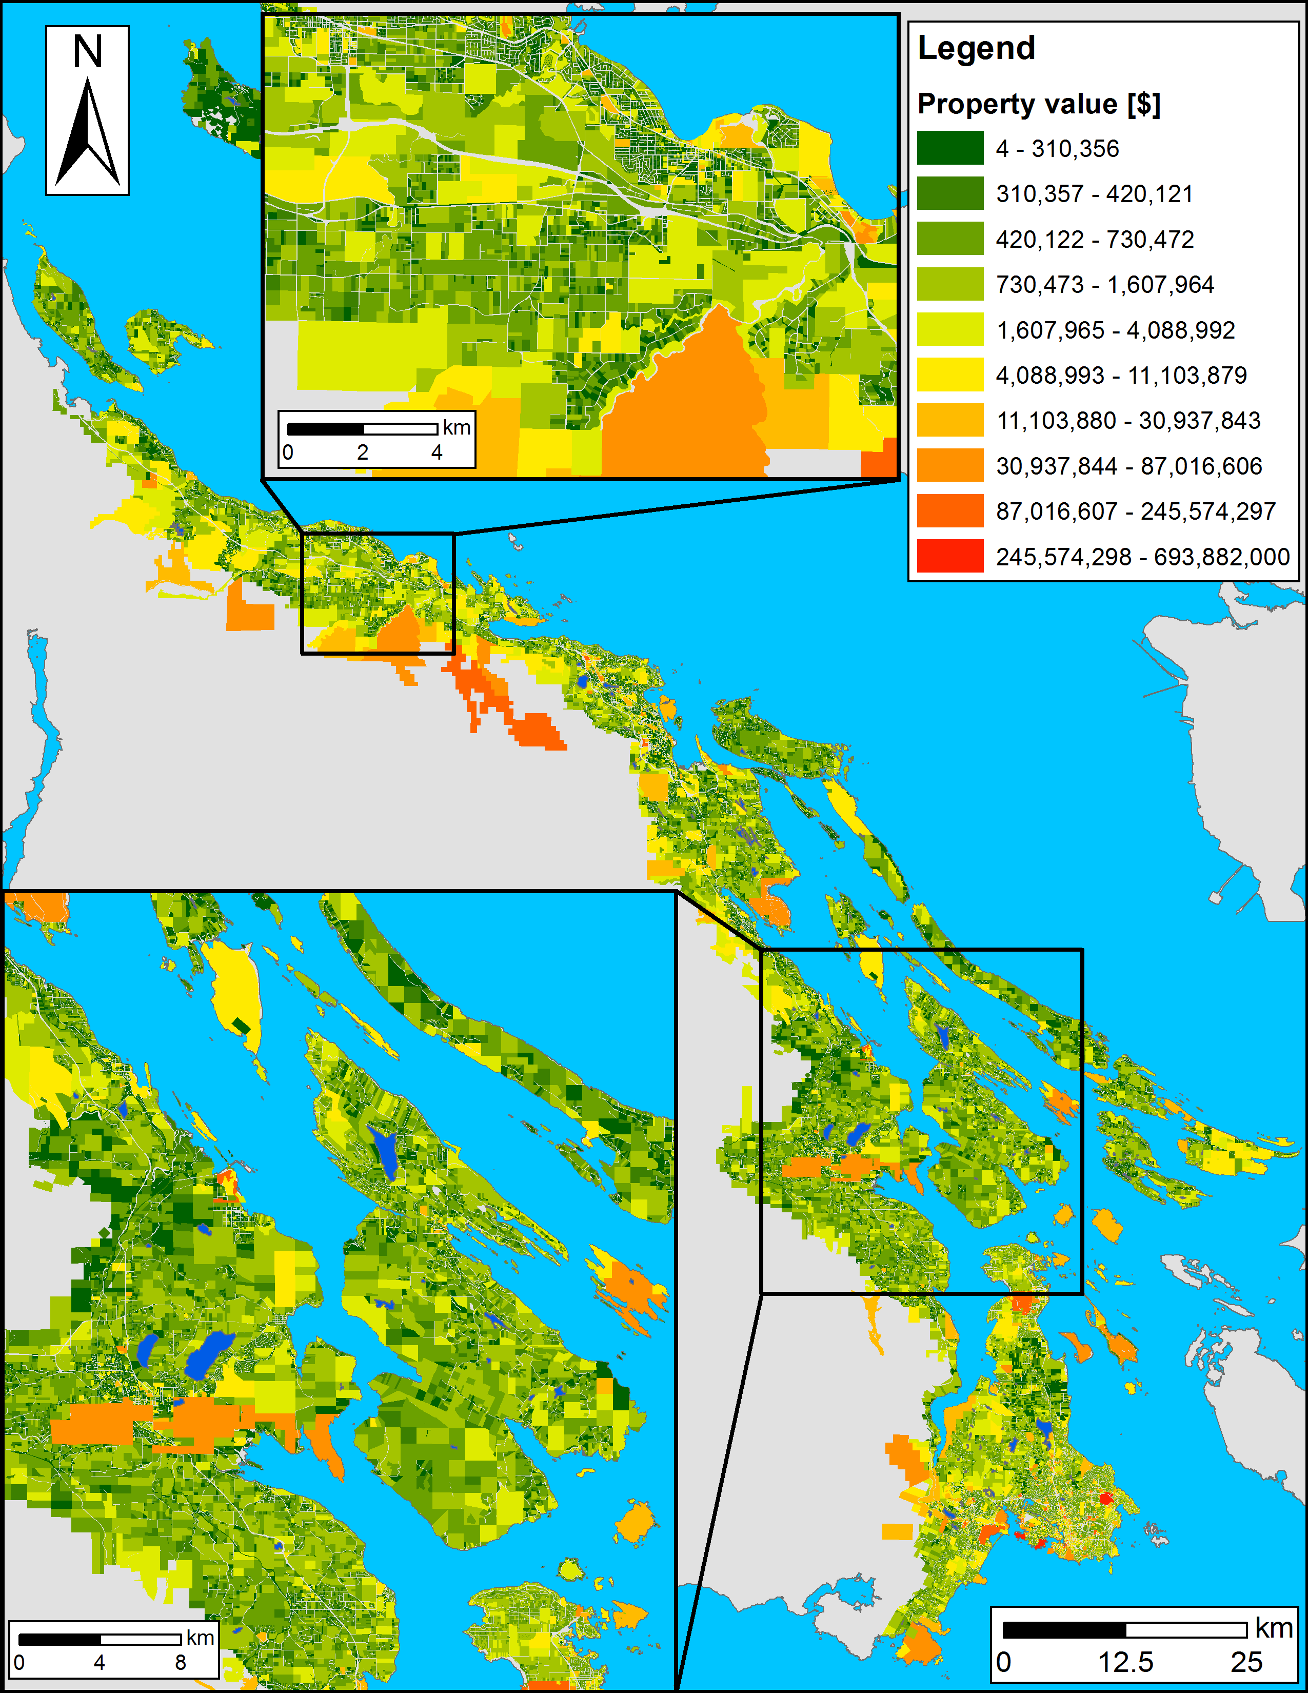
Planning units
Land base of the CDFCP: ~198,000 properties
Possible solutions for a reserve system: 2^198,000 > atoms in the Universe
How to optimize prioritization? Simulated Annealing

Slide 19










Coastal Douglas Fir Conservation Partnership: Facilitate Consensus Decisions on Protection

Slide 20

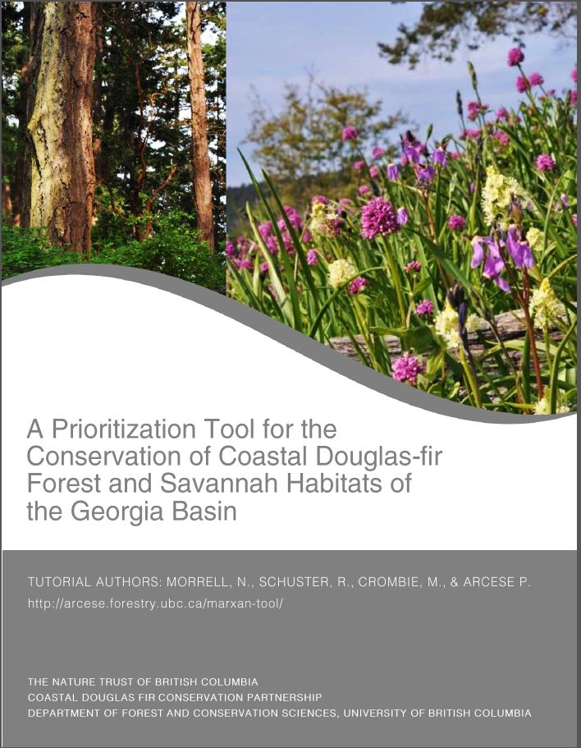
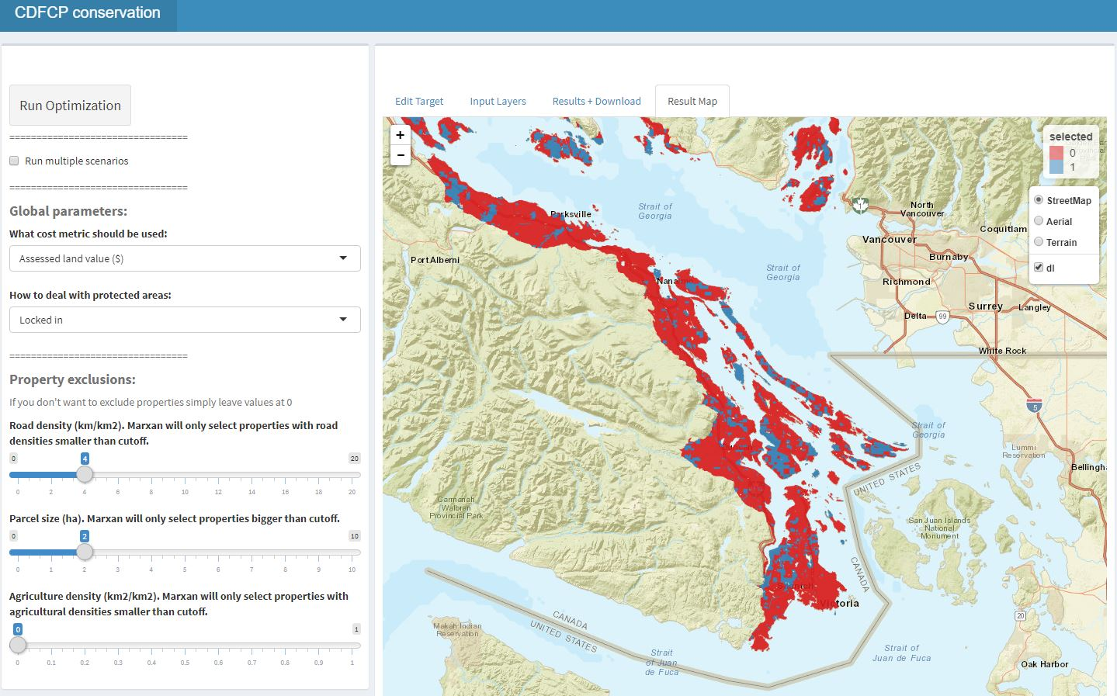
Current tool version
http://forbasin.forestry.ubc.ca/CDFCP_prioritization/

Slide 21
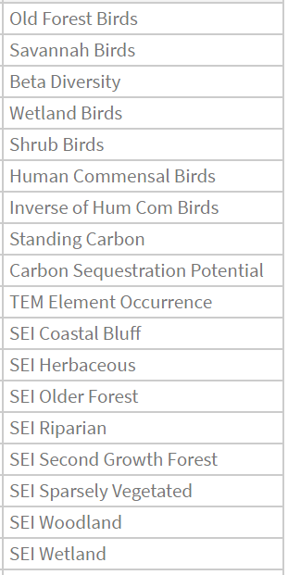
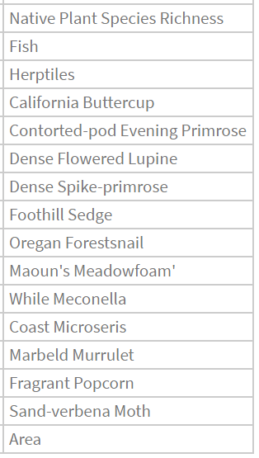

Slide 22
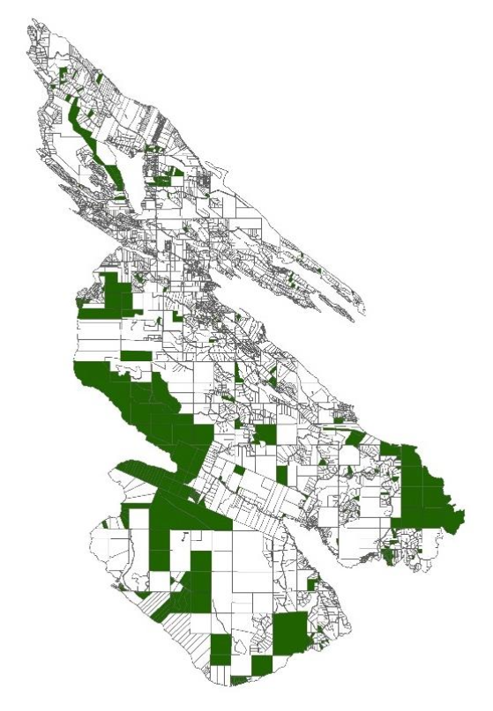
Applications?
Acquire Biodiverse Parcels
Minimize Management Costs, Maximize Return on Conservation Investments
Develop Contact Lists to Engage Private Landowners in Conservation at Landscape Scales

Slide 23


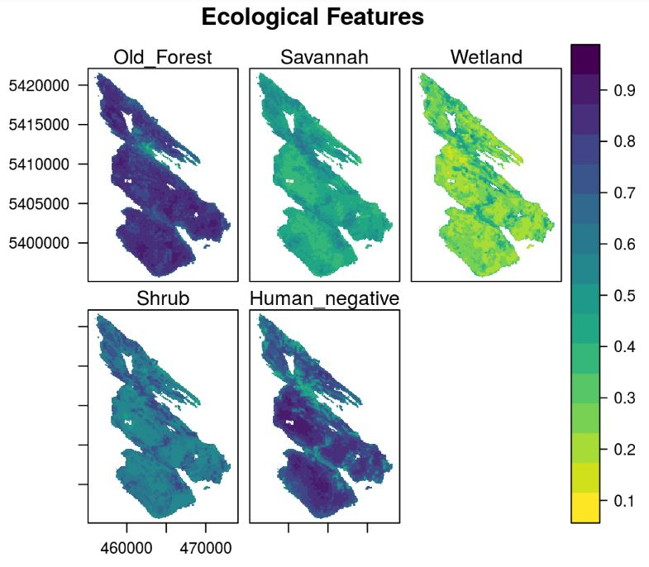
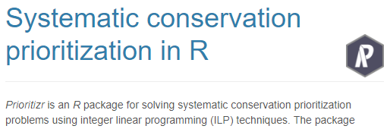
prioritizr
Hanson JO, Schuster R, Morrell N, Strimas-Mackey M, Watts ME, Arcese P, Bennett J, Possingham HP (2017). prioritizr: Systematic Conservation Prioritization in R. R package version 3.0.3.
https://github.com/prioritizr/prioritizr

Slide 24
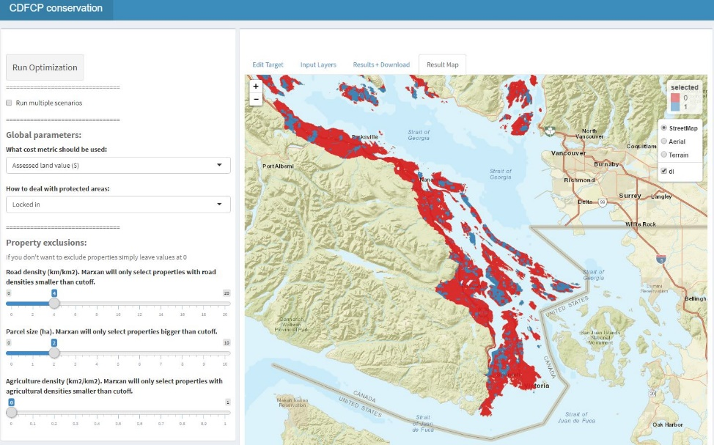
Under development
Combine CDFCP tool with prioritizr to allow users to interactively build and customize conservation planning problems.

Slide 25
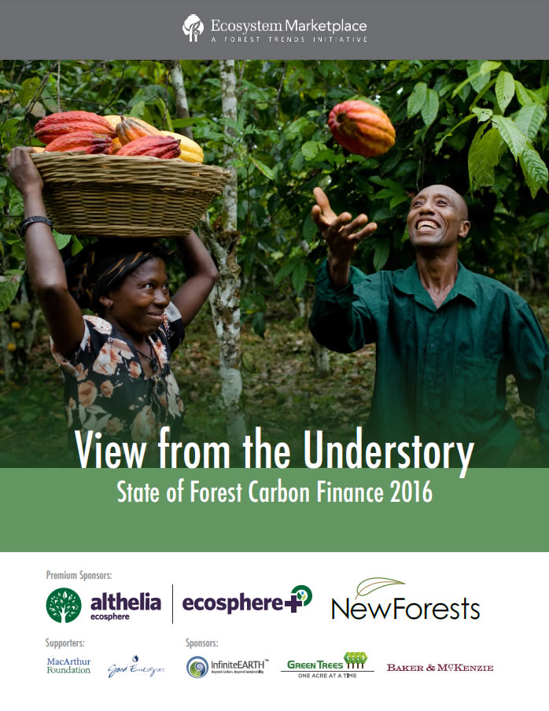
Payments for Ecosystem Services
$6 Billion Invested
to 2016 in Carbon

Slide 26

Synergies: High Value Forests Have Standing Carbon In Excess of 200 t/ha
Standing Carbon in High Value Forests in the Georgia Basin is Currently Worth $4-10K/ha
~3-15% of Acquisition Cost

Slide 27

Synergies: High Value Forests Are Often Adjacent to Younger Forest With High Sequestration
High Sequestration Rates in Young Forest May Facilitate Landscape Level Planning

Slide 28

Biodiversity – Carbon Synergy in the Conservation of Forested Land
Biodiversity features
β-diversity of Old Forest and Savanna Bird Communities
Carbon budget model
Standing Carbon
Sequestration potential
Cost metrics used:
Total Land Value (TLV)
TLV – Standing Carbon * $/t
TLV – Sequestration Potential (20a) * $/t
TVL – Stand. Carb *$/t – Sequ. Pot. * $/t
$/t presented: 12.5 (average cost payed by Pacific Carbon Trust)

Slide 29

Biodiversity - Carbon
Huge Initial Reductions in Cost Possible
Schuster, Martin & Arcese 2014 PLoS One

Slide 30

Exercise I: Carbon offsets
http://www.richard-schuster.com/ILP/

Slide 31




Strategic Investment for ‘Co-benefits’
Standing / Sequestered Carbon
Water Quality / Supply
Beneficial Farm Practices
Notes:
Think of a reverse auction as similar to when a homeowner solicits multiple bids for work from contractors. The homeowner puts together a scope of work, solicit bids, and chooses a contractor based on some combination of factors including price and quality.
Finally, based on estimates of the amount of habitat needed and the pricing of bids, BirdReturns accepted up to 80 percent of the bids. Each farmer received the price they bid. Just as with the contracting example, the lowest price didn’t always win, but it was a key criteria.
Farmer’s bids varied based on factors such as water cost, soil conditions, labor costs associated with creating the temporary habitat, and economic risks the program might create like not being able to plant on time in the spring.
BirdReturns has many advantages over conservation programs that set a single, uniform price for all farmers.
If the price is too low, there will be insufficient demand and too few farmers will sign up for the program. If the price is too high, there will be an excess of demand and the government will over-pay. In a time of huge societal needs and competing demands for scarce public dollars, such over-payment means that other valuable programs are not being funded.
In a reverse auction, the farmer sets the price, a price based on producing habitat. Farmers understand this intuitively. It is how they work, how they get paid for producing crops.
As one farmer put it at one of the Conservancy’s initial meetings: “You want us to grow birds, like we grow rice. We know how to do that.”
Farmer’s bids varied based on factors such as water cost, soil conditions, labor costs associated with creating the temporary habitat, and economic risks the program might create like not being able to plant on time in the spring.

Slide 32




Coastal Douglas-fir Carbon Co-Benefit
$96.7
Vancouver

Slide 33


Coastal Douglas-fir Carbon Co-Benefit
Cost of Solution
St + Seq Carbon
$9.7
Canadian Carbon Policy
$20/t by 2020

Slide 34

Coastal Douglas-fir Carbon
Co-Benefit
$9.7
$96.7
Assessed Value - Carbon ($1000s)
$31.2 $46.4 $46.8

Slide 35
Strategic Investment for ‘Co-benefits’
Standing / Sequestered Carbon
Water Quality / Supply
Beneficial Farm Practices
Notes:
Think of a reverse auction as similar to when a homeowner solicits multiple bids for work from contractors. The homeowner puts together a scope of work, solicit bids, and chooses a contractor based on some combination of factors including price and quality.
Finally, based on estimates of the amount of habitat needed and the pricing of bids, BirdReturns accepted up to 80 percent of the bids. Each farmer received the price they bid. Just as with the contracting example, the lowest price didn’t always win, but it was a key criteria.
Farmer’s bids varied based on factors such as water cost, soil conditions, labor costs associated with creating the temporary habitat, and economic risks the program might create like not being able to plant on time in the spring.
BirdReturns has many advantages over conservation programs that set a single, uniform price for all farmers.
If the price is too low, there will be insufficient demand and too few farmers will sign up for the program. If the price is too high, there will be an excess of demand and the government will over-pay. In a time of huge societal needs and competing demands for scarce public dollars, such over-payment means that other valuable programs are not being funded.
In a reverse auction, the farmer sets the price, a price based on producing habitat. Farmers understand this intuitively. It is how they work, how they get paid for producing crops.
As one farmer put it at one of the Conservancy’s initial meetings: “You want us to grow birds, like we grow rice. We know how to do that.”
Farmer’s bids varied based on factors such as water cost, soil conditions, labor costs associated with creating the temporary habitat, and economic risks the program might create like not being able to plant on time in the spring.

Slide 36
Exercise II: Complementarity
http://www.richard-schuster.com/ILP/

